Slide 1
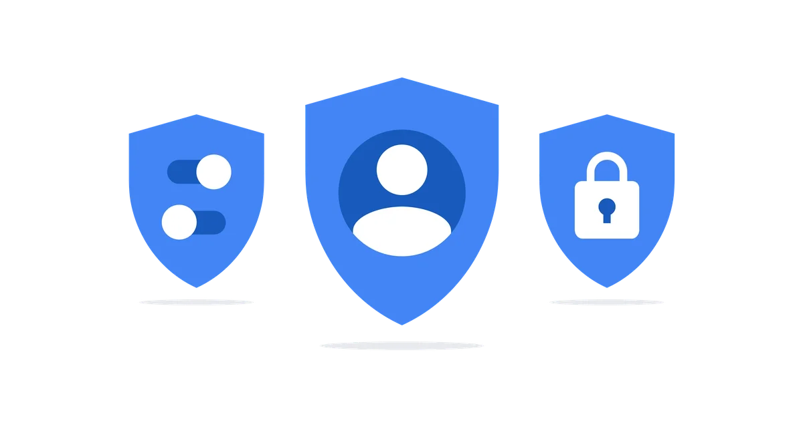
Privacy and Information Security Awareness
Date: 09-Jan-2024

Slide 2
AGENDA
Section 1: Introduction
Section 2: Information Security Threats
Section 3: Koantek Information Security Policies
Section 4: Koantek assets Do's and Don’ts
Section 5: Your Roles and Responsibilities
Section 6: Next steps & Competence assessment

Slide 3
Objective
Objective
Privacy and information security awareness training for Koantek Company's employees.
Goal
Educate and empower staff to understand and adhere to best practices, policies, and procedures in data protection, privacy, and information security.
Alignment
Training is designed to align with international standards, including ISO 27001, ISO 27701, and SOC 2 Type 2 compliance.
Mitigation
Aim to mitigate the risk of data breaches, unauthorized access, and security incidents through informed and compliant employee practices.
Culture
Foster a culture of awareness, responsibility, and compliance among employees.
Standards
Uphold the highest standards in information security to maintain the trust of stakeholders.

Slide 4
Section 1:
Introduction

Slide 5
SECTION 1: Introduction
What is an asset?
What is Information?
Examples of Information Assets.
What is Privacy?
Examples of Personal Identifiable Information (PII)
What is Information Security?

Slide 6
What is an ASSET?
An asset to an organization is any resource, tangible or intangible, that contributes to its value, effectiveness, or success, enhancing its overall capabilities and competitiveness.
Assets can include Hardware, Software, Digital, intellectual property, skilled personnel, and financial resources.

Slide 7
What is Information?
'Information is an asset which, like other important business assets, has value to an organization and consequently needs to be suitably protected
Product Specs/Source code
Operational Procedures
Financial documents
Client and Company Emails
People
Laptop/Desktop/Cloud
Credentials (Email/VPN/Customer env)
Office/Pdf reader/Other software

Slide 8
WHAT is PRIVACY?
‘A state in which one is not observed or disturbed by other people.’
Privacy works alongside information security by ensuring personal information is collected, used and disclosed appropriately.

Slide 9
Personally identifiable information (PII)
First Name | Last Name
Home Address
Personal Email address
Biometric Data
Health Information
Gender / Race
Any Government Issued Identification Number/Card
IP Address details

Slide 10
Section 2:
Information Security Threats

Slide 11
Understanding Information Security and Privacy Threats
Understanding Information Security and Privacy Threats
Phishing
Social Engineering
Ransomware
A phishing attack is a deceptive cybercrime technique where attackers masquerade as trustworthy entities, often through fake emails or websites, to trick individuals into divulging sensitive information such as passwords or financial details.
A social engineering attack is a manipulative tactic employed by cybercriminals to exploit human behavior, deceiving individuals into divulging confidential information or performing actions that compromise security.
A ransomware attack is a malicious act where cybercriminals encrypt a victim's files, demanding a ransom payment in exchange for the decryption key.

Slide 12
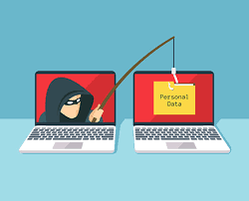
Phishing attacks
The goal is to exploit human psychology and compromise security by manipulating victims into unwittingly providing access to confidential data.
Privacy and Information Security Awareness
12

Slide 13
Spot the fake mail
FAKE / Phishing mail

Slide 14
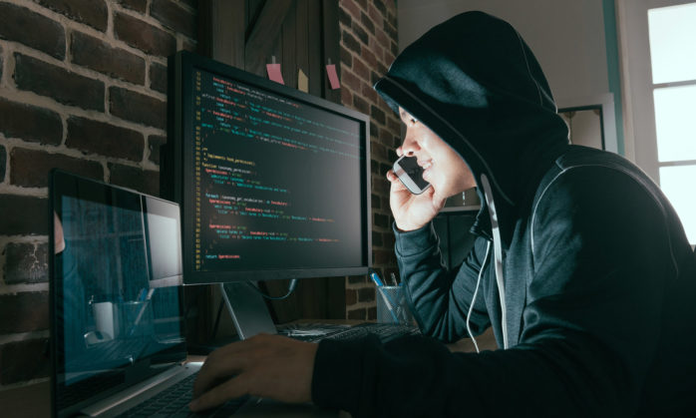
SOCIAL ENGINEERING attacks
It often involves psychological manipulation through impersonation, trust-building, or emotional manipulation to achieve the attacker's malicious objectives.
Privacy and Information Security Awareness
14

Slide 15
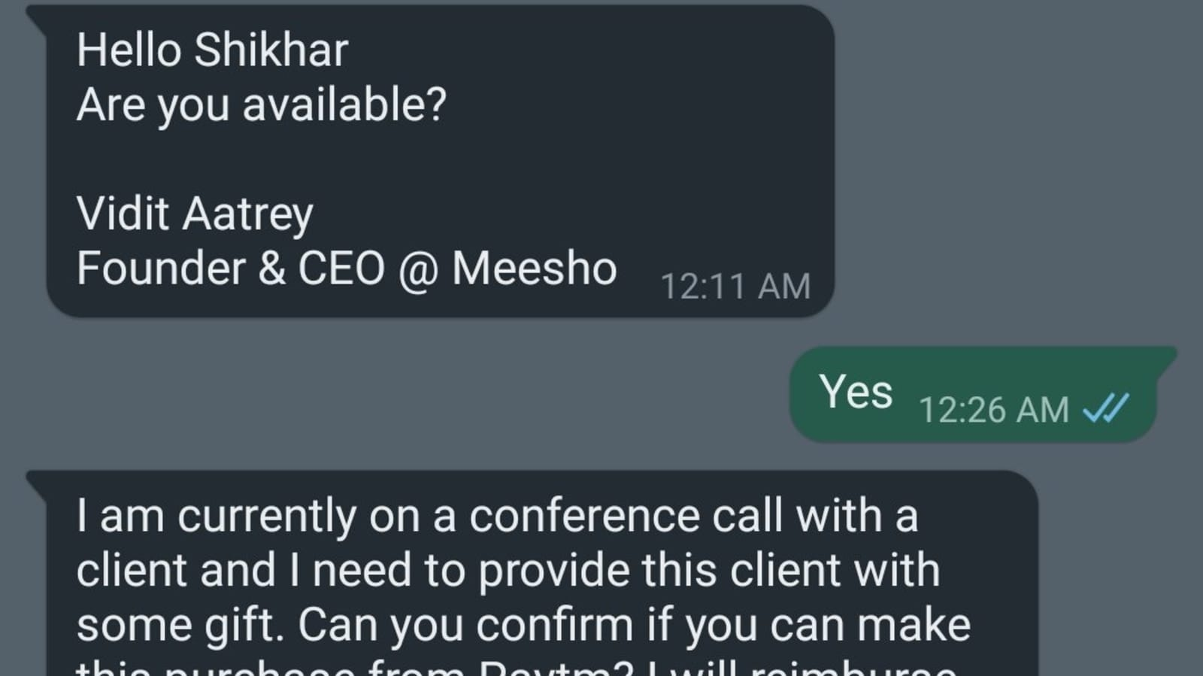
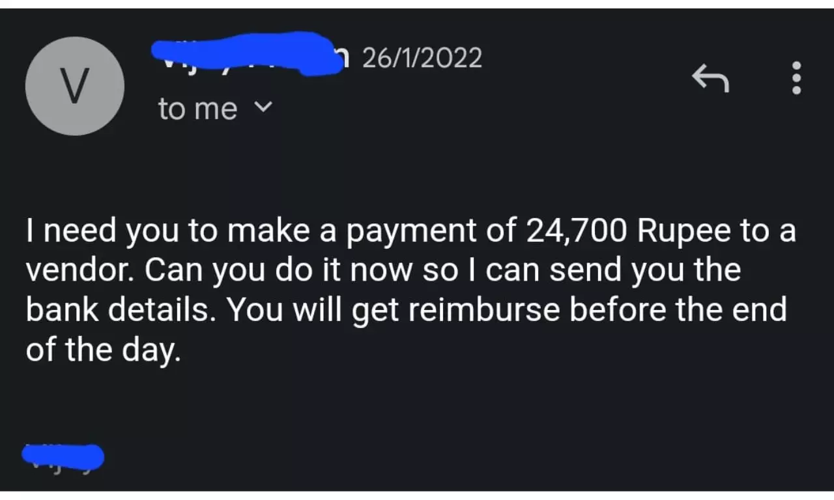
Unusual Requests or Urgency

Slide 16
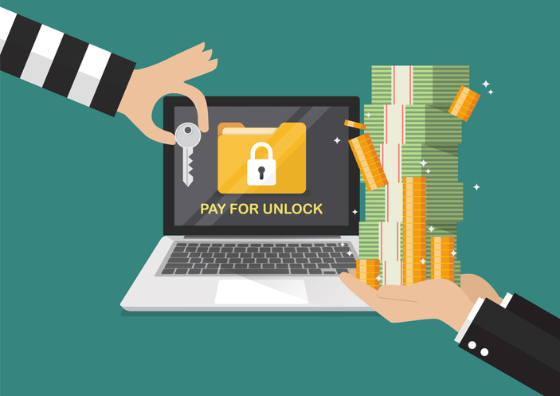
Ransomware attacks
It aims to extort individuals or organizations by restricting access to their data until the ransom is paid.
Privacy and Information Security Awareness
16

Slide 17
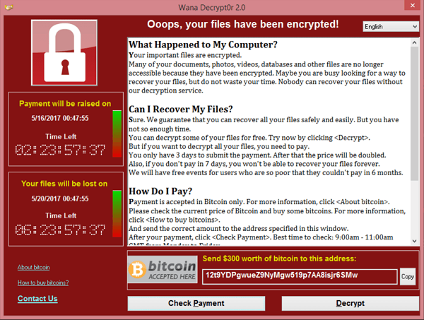
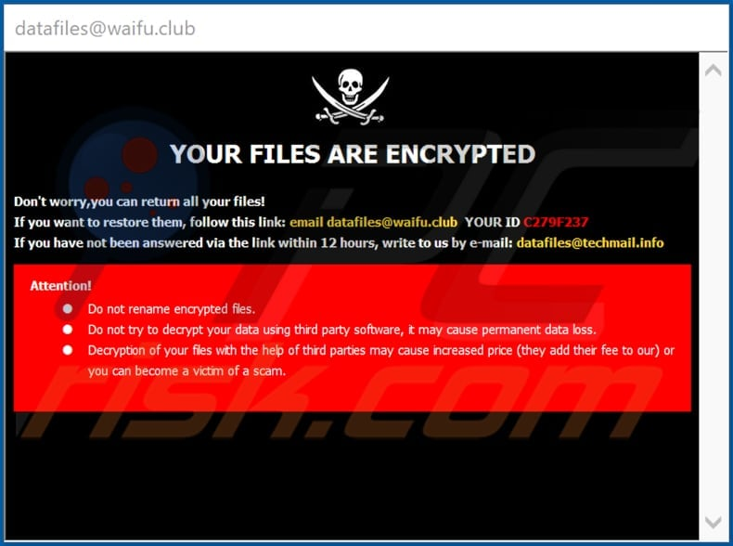
Ransomware Attacks

Slide 18
Section 3:
Koantek Information Security Policies

Slide 19
Information Security POLICIES
Access control Policy
Anti-Malware Policy
Acceptable Use Policy
Clear Desk and Clear Screen Policy
Cryptographic Policy
Electronic Communication Policy
Logging and Monitoring Policy
Privacy Personal Data Protection Policy
Mobile Device Policy
Teleworking Policy
Koantek’s Access Control Policy defines rules and procedures to regulate the authorization and restriction of user access to resources within a system, ensuring confidentiality, integrity, and availability.

Slide 20
Information Security POLICIES
Access control Policy
Anti-Malware Policy
Acceptable Use Policy
Clear Desk and Clear Screen Policy
Cryptographic Policy
Electronic Communication Policy
Logging and Monitoring Policy
Privacy Personal Data Protection Policy
Mobile Device Policy
Teleworking Policy
Koantek’s Antimalware Policy outlines guidelines and procedures to prevent, detect, and respond to malicious software threats, safeguarding computer systems and networks from potential infections and data breaches.

Slide 21
Information Security POLICIES
Access control Policy
Anti-Malware Policy
Acceptable Use Policy
Clear Desk and Clear Screen Policy
Cryptographic Policy
Electronic Communication Policy
Logging and Monitoring Policy
Privacy Personal Data Protection Policy
Mobile Device Policy
Teleworking Policy
Koantek’s Acceptable Use Policy (AUP) delineates the acceptable behaviors and restrictions for individuals using a network, system, or service, ensuring responsible and secure utilization while minimizing potential risks.

Slide 22
Information Security POLICIES
Access control Policy
Anti-Malware Policy
Acceptable Use Policy
Clear Desk and Clear Screen Policy
Cryptographic Policy
Electronic Communication Policy
Logging and Monitoring Policy
Privacy Personal Data Protection Policy
Mobile Device Policy
Teleworking Policy
Koantek’s Clear desk and clear screen policy mandates the secure and confidential handling of information by requiring employees to clear their desks and screens of sensitive materials when not in use, minimizing the risk of unauthorized access or data breaches.

Slide 23
Information Security POLICIES
Access control Policy
Anti-Malware Policy
Acceptable Use Policy
Clear Desk and Clear Screen Policy
Cryptographic Policy
Electronic Communication Policy
Logging and Monitoring Policy
Privacy Personal Data Protection Policy
Mobile Device Policy
Teleworking Policy
Koantek’s Cryptographic policy establishes guidelines for the secure implementation and use of cryptographic techniques to protect data confidentiality, integrity, and authentication within an organization's information security framework.

Slide 24
Information Security POLICIES
Access control Policy
Anti-Malware Policy
Acceptable Use Policy
Clear Desk and Clear Screen Policy
Cryptographic Policy
Electronic Communication Policy
Logging and Monitoring Policy
Privacy Personal Data Protection Policy
Mobile Device Policy
Teleworking Policy
Koantek’s Electronic Communication Policy defines rules and standards governing the appropriate and secure use of electronic communication tools within an organization, promoting effective communication while ensuring information security and compliance.

Slide 25
Information Security POLICIES
Access control Policy
Anti-Malware Policy
Acceptable Use Policy
Clear Desk and Clear Screen Policy
Cryptographic Policy
Electronic Communication Policy
Logging and Monitoring Policy
Privacy Personal Data Protection Policy
Mobile Device Policy
Teleworking Policy
Koantek’s Logging and Monitoring Policy outlines procedures for systematically recording and analyzing system activities, ensuring proactive identification of security incidents, and maintaining the integrity and availability of digital assets.

Slide 26
Information Security POLICIES
Access control Policy
Anti-Malware Policy
Acceptable Use Policy
Clear Desk and Clear Screen Policy
Cryptographic Policy
Electronic Communication Policy
Logging and Monitoring Policy
Privacy Personal Data Protection Policy
Mobile Device Policy
Teleworking Policy
Koantek’s Privacy Personal Data Protection Policy establishes guidelines for the lawful and responsible collection, processing, and protection of personal data, safeguarding individuals' privacy rights within an organization.

Slide 27
Information Security POLICIES
Access control Policy
Anti-Malware Policy
Acceptable Use Policy
Clear Desk and Clear Screen Policy
Cryptographic Policy
Electronic Communication Policy
Logging and Monitoring Policy
Privacy Personal Data Protection Policy
Mobile Device Policy
Teleworking Policy
Koantek’s Mobile Device Policy sets guidelines for the secure and responsible use of mobile devices within an organization, ensuring data protection, network security, and adherence to corporate policies.

Slide 28
Information Security POLICIES
Access control Policy
Anti-Malware Policy
Acceptable Use Policy
Clear Desk and Clear Screen Policy
Cryptographic Policy
Electronic Communication Policy
Logging and Monitoring Policy
Privacy Personal Data Protection Policy
Mobile Device Policy
Teleworking Policy
Koantek’s Teleworking Policy establishes guidelines for remote work, defining expectations, security protocols, and best practices to ensure productivity, data protection, and information security.

Slide 29
Section 4:
Koantek assets Do's and Don’ts

Slide 30
Koantek assets Do's
Save your work and shut down your laptop every day after completing your work
Laptop Should always be kept on a flat surface with sufficient air circulation.
The laptop must be password protected.
Antivirus must be installed if not please raise a support ticket to the IT team.
Lock the laptop when not in use.
Use laptop on hard, flat, non-cloth surface. Using cooling pad can decrease heat & increase performance, It also recommended to use the laptop in a room temperature of 0°C to 30°C.
Use compressed air to clean the vents on a regular basis.
Use a keyboard cover to protect keyboard from external conditions. This cover also safeguards from spilled food & drink, regularly clean your keyboard with a soft brush to remove dust particles.

Slide 31
Koantek assets Don’ts
Do not pick up your laptop by the screen.
Do not lend the Laptop or any Koantek asset to ANYONE.
Do not place heavy objects on the Laptop.
Do not connect any foreign objects into the ports.
Avoid keeping your laptop on Blanket, Pillows, etc., It blocks the heat sink and crashes your laptop.
Do not use other chargers/adapters for your laptops other than the company provided ones.
Do not install any other applications other than work-related. Please do not install game or third-party software which are not related to work.
Avoid placing food and liquids near the laptop as the liquid damage isn’t covered by warranty.
Always save your work to google drive. Do not store any personal information. We do not take. responsibility for data loss.
Do not throw your laptop on the bed as it can damage the hardware.
Do not tap with your hands or any objects on the LCD display.
Do not connect your cell phone or any other devices through your laptop. By doing so there are chances that it might corrupt the Operating System.
Do not paste any sticker on the laptop surface.

Slide 32
Section 5:
Your Roles and Responsibilities

Slide 33
Line Managers – Responsibilities
Department Managers may be heads or supervisors of operational units within the organization.
Responsibilities
A Department Manager has the following responsibilities:
Review and manage employee competencies and training needs to enable them to perform their role effectively within the information security area.
Ensure that employees are aware of the relevance and importance of their activities and how they contribute to the achievement of information security objectives.
Review your team members access requirements (USB/Local Admin/Software installation/Client VPN/Git Access) and recommend.
Authorities
A Department Manager has the authority to:
Arrange training and awareness activities for the employees under their direction, within budget constraints.
Take action to prevent an information security incident from occurring or escalating, where possible

Slide 34
IT Admin/Managers – Responsibilities
Due to the often-technical nature of information security issues, IT Admins have an important part to play in the ISMS.
Responsibilities
IT Admins generally have the following responsibilities:
Operation of processes such as incident and change management.
Provision of technical expertise in matters of information security
Implementation of technical controls
System administration e.g. user creation, backups
Security monitoring e.g. network intrusions
Authorities
An IT Admins has the authority to:
Take action to prevent an information security incident from occurring or escalating, where possible

Slide 35
IT USERS – Responsibilities
The responsibilities of IT users are defined in a variety of organization-wide policies, such as the Internet Acceptable Use Policy and are only summarized in brief below.
Responsibilities
An IT user has the following main responsibilities:
Ensure that you are aware of and comply with all information security policies of the organization relevant to your business role.
Report any actual or potential security breaches.
Contribute to risk assessment where required.
Adhere to companies policies and procedures.
Authorities
An IT user has the authority to:
Take action to prevent an information security incident from occurring or escalating, where possible.

Slide 36
Section 6:
Next steps & Competence assessment

Slide 37
Next steps…
Review and acknowledge Koantek’s Staff Handbook:
https://drive.google.com/file/d/11oHXtuZZH5BgXWkbDAO3KUEdGbjDYCso/view?usp=sharing
Review and adhere to Business conduct and ethics
https://myhr.koantek.com/koantek/pdfViewer.zp?fileId=674083000001708065---
Review and sign Koantek’s Non-Disclosure Agreement
https://docs.google.com/document/d/1XL4klV9HZzgaSuSlLw8QpddhOn_VEaxi/edit?usp=drive_web&ouid=116838986582368980723&rtpof=true
Additionally review all relevant policies of Koantek and adhere to them.
https://myhr.koantek.com/koantek/pdfViewer.zp?fileId=674083000002080191--Information
Complete Competence assessment
https://deep.cycops.co.in/

Slide 38
Competence assessment
Competence Test will be Jan 11th 2024.
Credentials to access the LMS will be emailed.
Taking the exam and demonstrating competence in information security is a mandatory requirement for all individuals.

Slide 39
Questions?

Slide 40
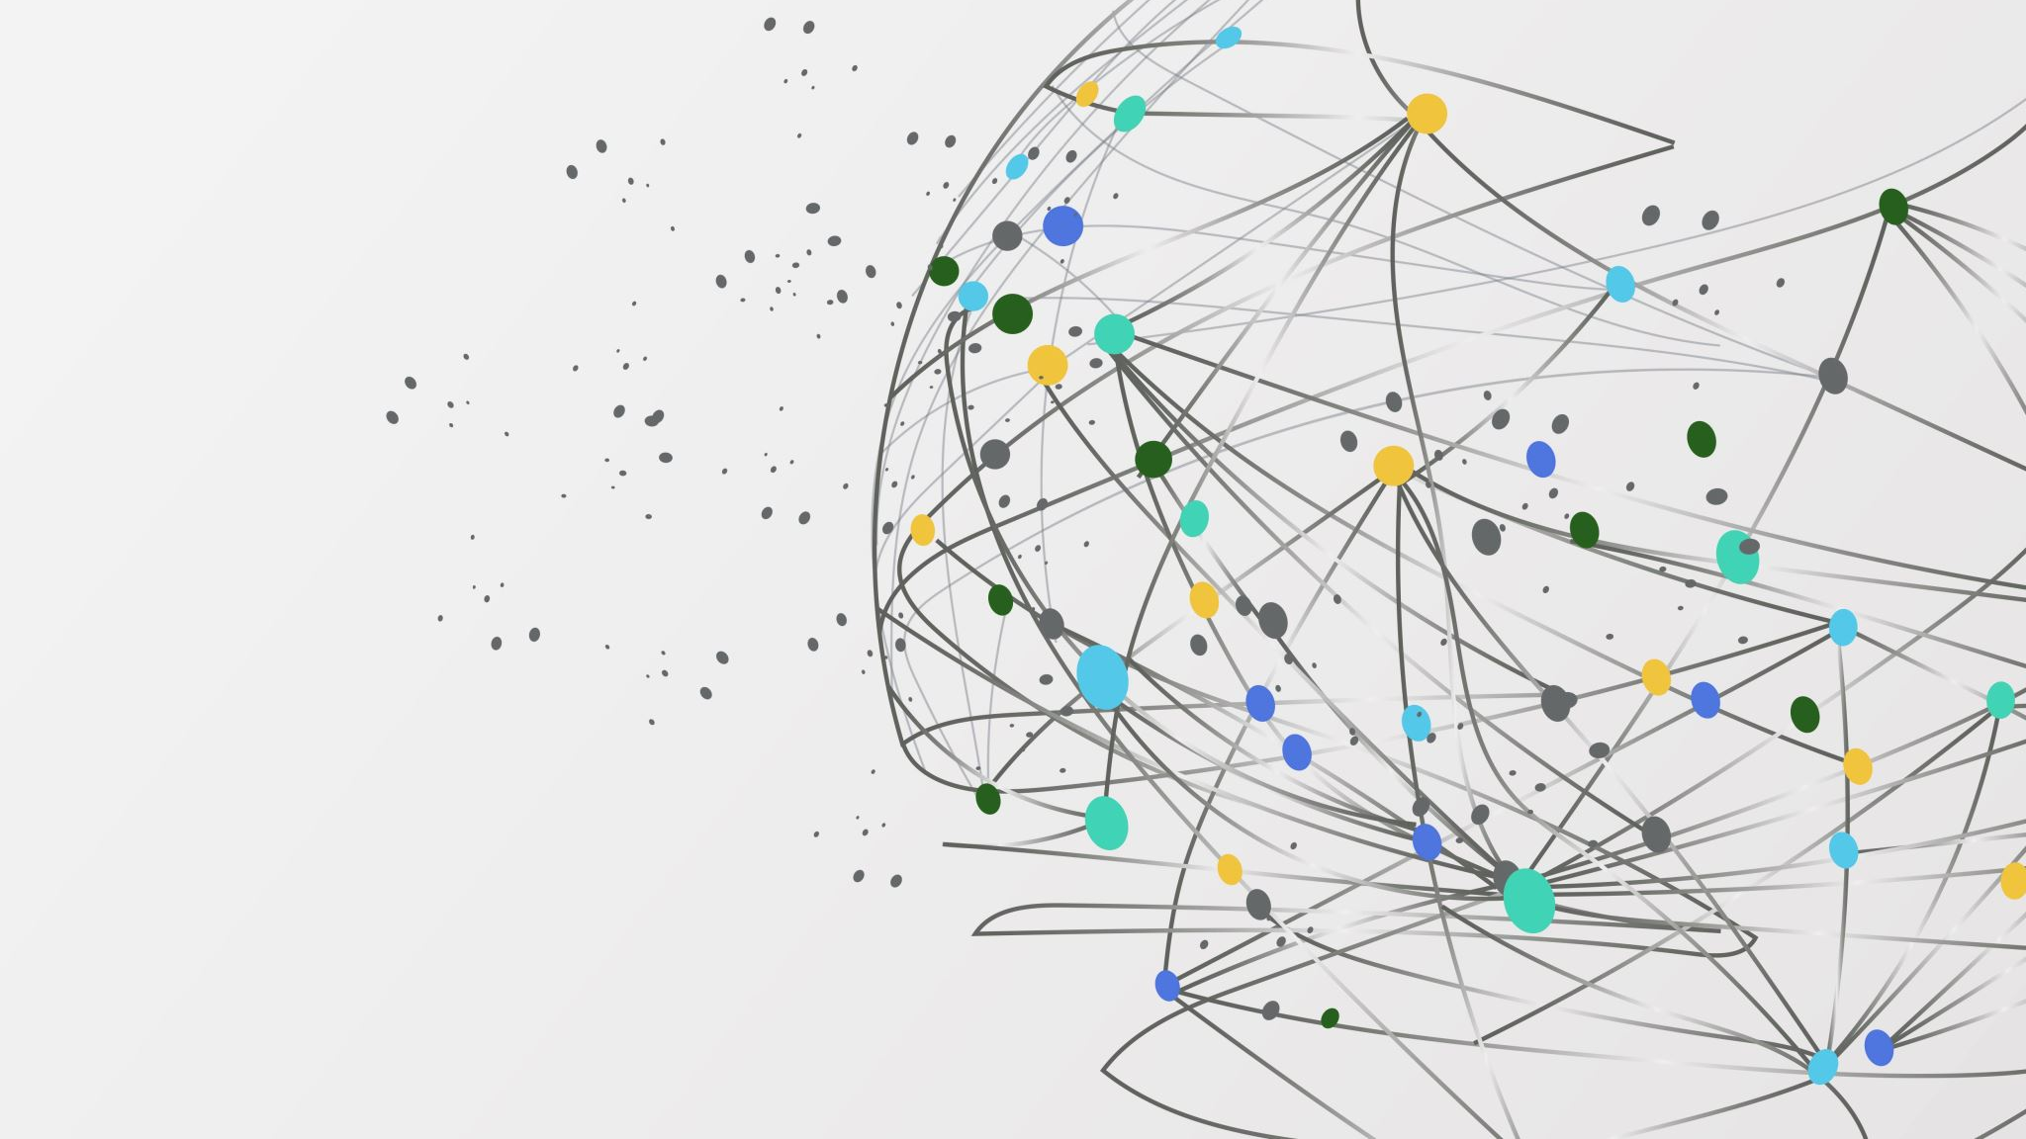
Thank YOU!

